Slide 1

Network Infrastructure
Advanced Enterprise Network Design
supervised by DR. [ Hussein Harb]
instructor [ENG. El hussein ahmed ]

Slide 2






Meet Our Team
Team Leader
Ahmed Yasser Aziz
Ziad Mouawad Mahfouz
Habib Wael Suleiman
21037860
21037860
21037860
Amr Tarek Abdul-Muttalib
Saeed Khaled Saeed
Morcos osama rawhy
21016718
21024201
21095401
KEY TAKEAWAYS

Slide 3

Part 0: Overview
Full Network Overview
PRESENTED BY HABIB & AHMED

Slide 4
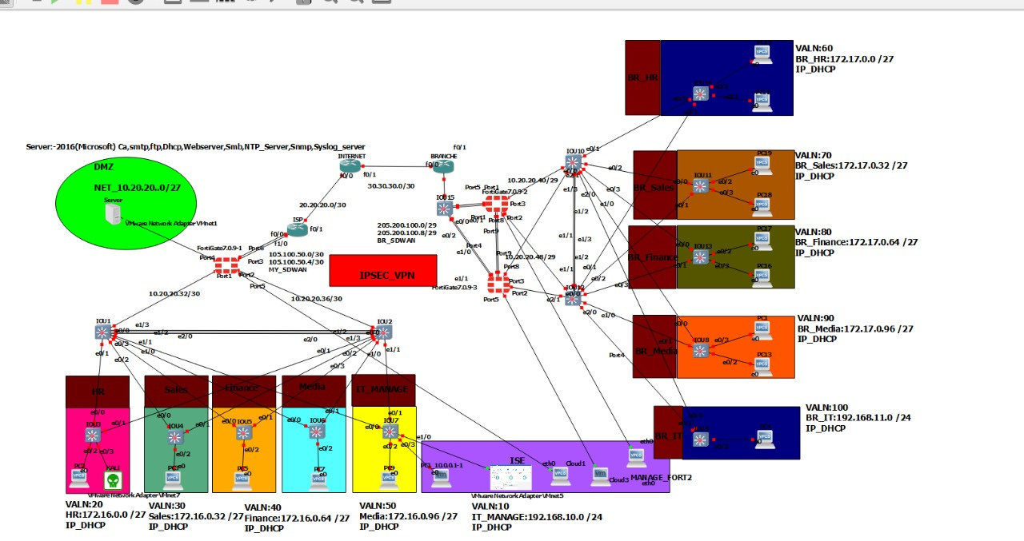
Overview
Network Topology Overview

Slide 5
Overview
Network Topology Overview
This enterprise network is designed with full segmentation across HQ, DMZ, and Branches. The architecture includes core routing, access switches, firewalls, servers, and WAN connections to ensure security, scalability, and organized communication across all departments.

Slide 6
Overview
High-Level Structure
The HQ contains the main core routers and access switches. A DMZ hosts public services behind the firewall. Multiple branches connect to HQ using secure WAN links. Each department and branch is separated using VLANs for better security and performance.

Slide 7
Overview
Main Components
The network consists of:
– Core routers for internal routing – Access switches for user connectivity
– FortiGate firewall for security – Servers for internal services
– DMZ for public-facing services – Branch routers and switches for remote connectivity

Slide 8
Overview
Data Flow
User traffic flows from access switches to the core, then to the firewall and servers. Branch traffic moves through the WAN into HQ to access required services. This structured flow ensures controlled, secure communication across all network segments.

Slide 9

Part 1
HQ Access Switches
PRESENTED BY ZEYAD

Slide 10
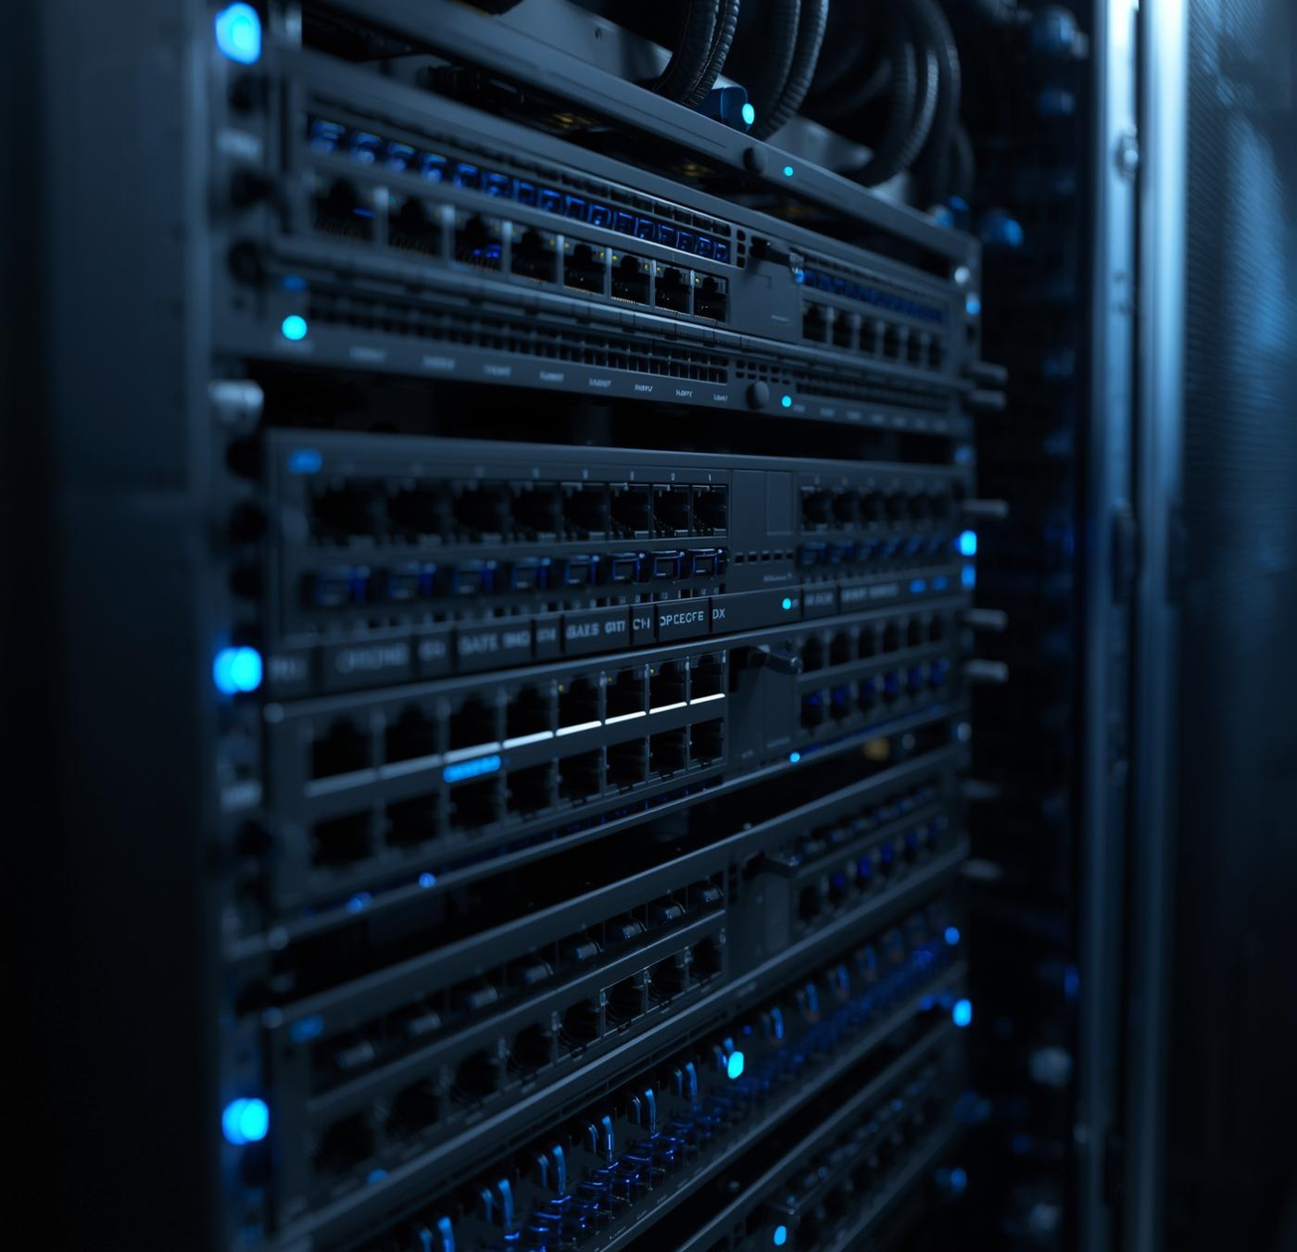
Access Layer Overview
The HQ access layer consists of six switches serving :
HR , Sales
, Finance, Media,
IT, IOU1,
and IOU2.
These switches connect all end-user devices, printers, and workstations to the internal network.

Slide 11


VLAN Assignment
Each department has a dedicated VLAN:
HR → VLAN 20,
Sales → VLAN 30,
Finance → VLAN 40,
Media → VLAN 50,
IT_Manage → VLAN 10.
IOU1 and IOU2 are used as uplinks to the core. VLANs provide isolation and reduce broadcast traffic.

Slide 12


Switch Configuration
Trunk vs Access
Understanding the differences between trunk and access links is crucial for network efficiency, allowing effective VLAN tagging and optimizing data flow across network devices.
All access ports are configured with the correct VLANs. Trunk ports are used to carry multiple VLANs to the core and firewall. DHCP relay ensures users receive IP addresses from the DHCP server.

Slide 13

VLAN Gateways in HQ
Each HQ department uses a unique gateway assigned to its VLAN:
HR → VLAN 20 → Gateway 10.0.20.1
Sales → VLAN 30 → Gateway 10.0.30.1
Finance → VLAN 40 → Gateway 10.0.40.1
Media → VLAN 50 → Gateway 10.0.50.1
IT → VLAN 10 → Gateway 10.0.10.1
These gateways ensure users can communicate with the core router and access higher layers such as servers and the firewall.

Slide 14


Connectivity Testing
Cybersecurity Verification
The system indicates a secure connection, confirmed by glowing green checkmarks and successful ping signals, ensuring data integrity and reliability across the network.
Ping tests were performed between departments, confirming successful VLAN operation and communication with servers. All HQ users were able to reach the core, firewall, and internal services

Slide 15


Part 2:
FortiGate Firewall Overview
Presented by [Habib,ahmed ,amr]

Slide 16


Firewall Role
FSSO (Fortinet Single Sign-On)
Integrates Fortigate with Active Directory
Automatically maps Usernames + IP Addresses
Enables identity-based firewall policies
No login required for users on the firewall
Centralized control and accurate logging
IPsec VPN (Site-to-Site — Custom Mode)
Secure permanent tunnel between HQ and Branch
Uses Phase 1 (IKE) and Phase 2 (IPsec) parameters
Phase 1: AES256, SHA256, DH14, Pre-Shared Key
Phase 2: AES256, SHA256, Local ↔ Remote subnets
Static routes + firewall policies allow traffic flow
Custom mode provides full control and flexibility

Slide 17
Firewall Role
The FortiGate acts as the primary security gateway for the entire HQ.
It filters traffic between LAN, DMZ, and WAN, ensuring only authorized connections pass through.

Slide 18
Firewall Policies
Security policies control communication between VLANs and servers.
DMZ traffic is strictly filtered.
Internet access is provided through NAT,
with specific permissions based on department needs.

Slide 19
Firewall Routing Design
The FortiGate firewall contains the main routing table for the network. All VLAN gateways are connected to it, and static routes are configured to reach branch networks through the WAN interface.
Default Route
A default route is configured on the FortiGate pointing to the ISP gateway.
This allows internal hosts to reach the internet through NAT while keeping internal routing fully controlled by the firewall.

Slide 20


NAT and Routing
Source NAT enables internal users to access the internet.
Static routes and internal routing ensure proper communication between HQ,
branches, and servers.
A default route points to the ISP.

Slide 21

DMZ Protection
The DMZ is isolated behind the firewall.
Only essential services such as web, DNS, and email are accessible.
All traffic between the DMZ and LAN is controlled by strict firewall rules

Slide 22

Part 3:
FortiGate HA (High Availability)
Presented by Saeed

Slide 23
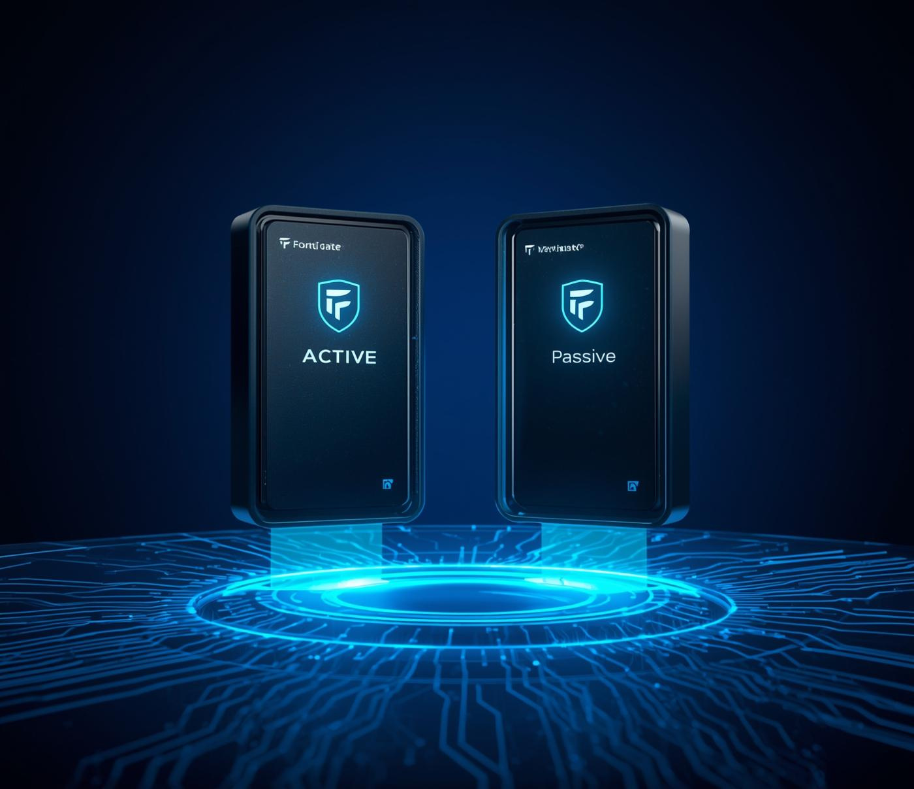
High Availability Overview
The FortiGate HA pair provides redundancy and ensures continuous firewall operation.
Active–Passive mode is used to maintain stability in case one device fails.

Slide 24

Synchronization and Heartbeat
HA synchronization keeps both firewalls identical by sharing configurations and sessions.
Heartbeat links monitor device health, enabling fast failover if needed.

Slide 25

Failover Mechanism
If the active firewall fails, the passive firewall immediately takes over.
This prevents downtime and maintains continuous access to HQ services, WAN, and DMZ.
EFFORTLESS TRANSITION BETWEEN NETWORK PATHS
Experience uninterrupted service with seamless failover.

Slide 26
Routing with HA
The HA pair synchronizes routing tables between both firewall nodes.
This ensures that if the active firewall fails, the standby firewall retains:
– All static routes
– VLAN gateways
– DMZ routes
– WAN routes
Failover happens without losing routing state

Slide 27

WAN & SD-WAN
The HA setup integrates with WAN and SD-WAN interfaces,
ensuring link stability and traffic optimization.
This guarantees consistent connectivity for HQ and branch sites.

Slide 28


PART 4
Network Segmentation Branch Access Switches
Presented by [Morcos]

Slide 29


Branch Network Overview
Each branch includes its own dedicated access switch connecting local users.
Branch switches link to branch routers,
which then connect to HQ through secure WAN paths.

Slide 30
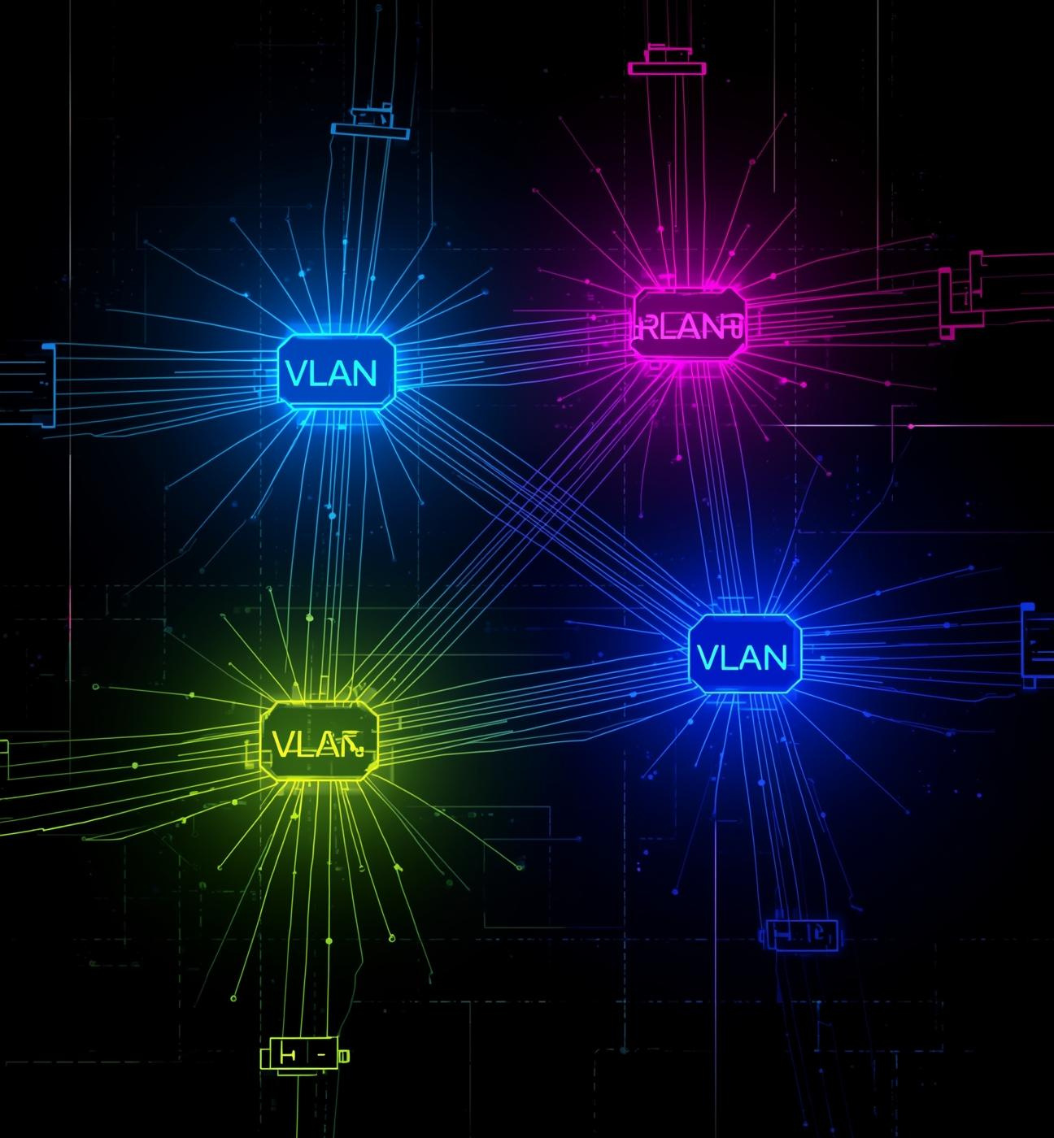
VLAN Structure
Branches use separate VLANs such as VLAN 60, 70, 80, 90, and 100.
Each VLAN uses a /27 subnet supporting up to 30 hosts,
ensuring organized addressing and segmentation.

Slide 31
Branch Routing
Branch routers handle the local routing for their VLANs and forward all traffic to HQ through a point-to-point WAN link.
Routing is static to ensure stable and controlled paths

Slide 32
Branch Default Gateways
Each branch VLAN has its own gateway:
BR-HR → VLAN 60 → Gateway 10.0.60.1
BR-Sales → VLAN 70 → Gateway 10.0.70.1
BR-Finance → VLAN 80 → Gateway 10.0.80.1
BR-Media → VLAN 90 → Gateway 10.0.90.1
BR-IT → VLAN 100 → Gateway 10.0.100.1
Branch users use HQ DHCP but rely on their local gateway for first-hop routing.

Slide 33

Connectivity and DHCP
Visualizing packet transmission efficiency
Branch users receive IP addresses from the HQ DHCP server through relay.
All branch VLANs communicate with HQ servers through the branch firewall and core network.

Slide 34


Testing and Verification
Connectivity tests confirmed that branch users can reach HQ servers, the DMZ, and other branches.
Ping and traceroute tests validated the stability and correct routing of branch networks.

Slide 35


Part 5:
Servers (HQ + DMZ)
& routing
(HQ & BRANCH)
Presented by [Amr, ahmed]

Slide 36

Server Roles
The servers include DHCP, DNS, NTP/MTP, IIS, SMTP, and FTP.
Each server provides essential services required for the operation of HQ and branch networks.

Slide 37


Abstract Visualization of DHCP
The DHCP server manages IP addressing for all VLANs.
Each VLAN has its own scope, ensuring proper automatic address assignment across HQ and branches.

Slide 38
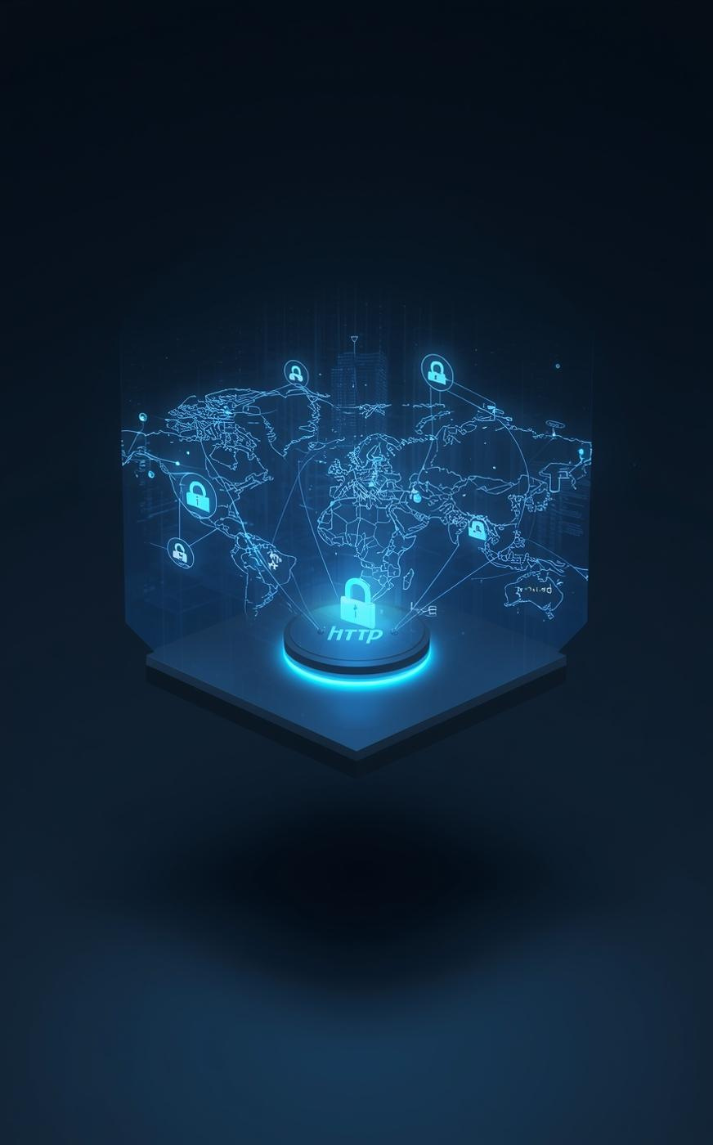

DNS and Web Services
DNS handles internal name resolution for all users.
IIS hosts internal web applications accessible from authorized VLANs.
NTP ensures all devices maintain synchronized time.

Slide 39
Server Network Gateways
All servers are placed in a secured VLAN with a dedicated gateway (e.g., 10.0.1.1).
This gateway ensures servers can communicate with HQ VLANs, DMZ, and branch users through controlled firewall policies.
Routing for Services
DNS, DHCP, IIS, and NTP services rely on correct routing between VLANs.
Static routes guarantee that server replies return through the firewall and core router back to HQ and branches.

Slide 40
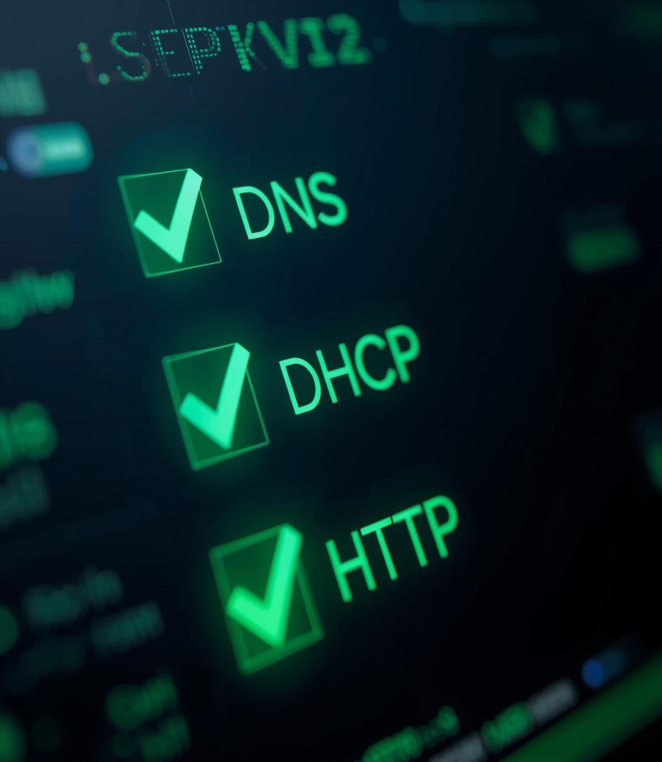

Server Validation
Functional tests confirmed DHCP leasing, DNS resolution, NTP sync, and IIS service accessibility.
All services were successfully reachable from HQ and branch networks.

Slide 41


Part 6:
Cisco
ISE Integration
Presented by [Ahmed]

Slide 42

Cisco ISE Overview
Cisco ISE provides centralized authentication, authorization, and accounting.
It ensures that only trusted users and devices gain access to the network.

Slide 43
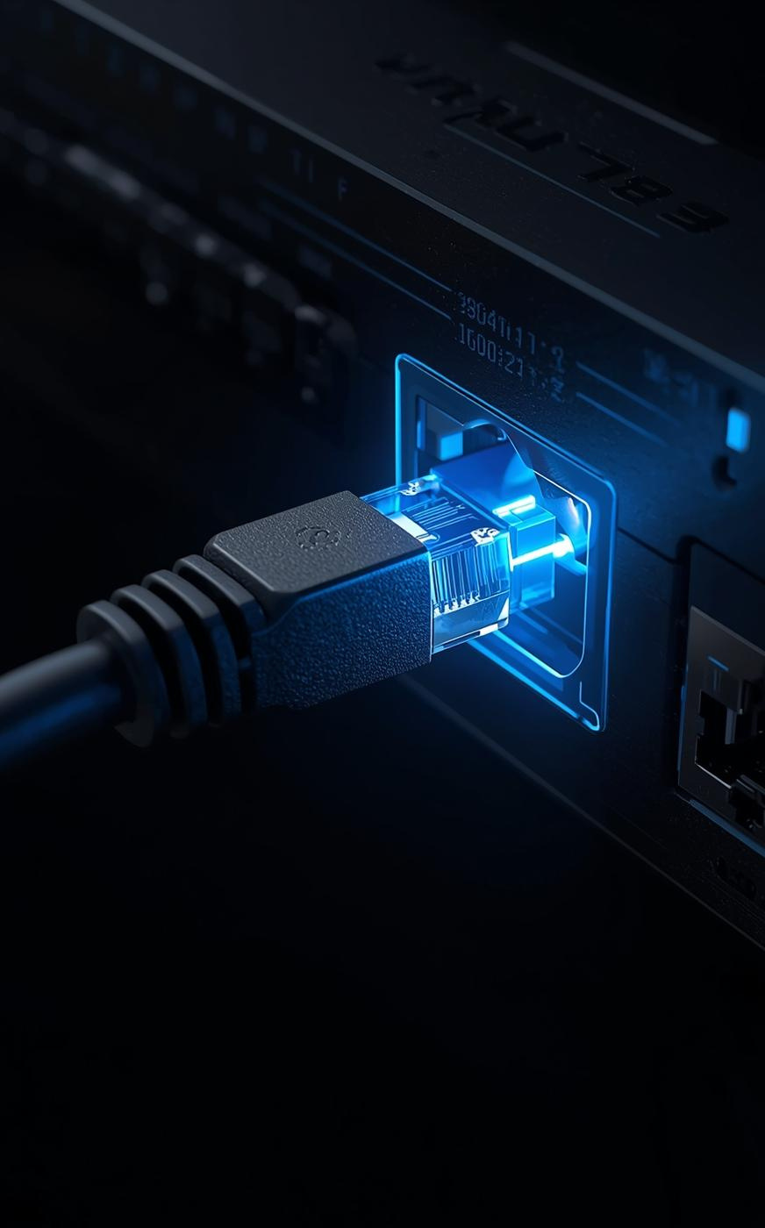

802.1X ntegration
The IOU7 switch is configured to authenticate users via 802.1X.
Devices must pass identity checks before joining the network, improving overall security.

Slide 44
ISE Routing
Cisco ISE is placed in a dedicated VLAN with its own gateway (e.g., 10.0.5.1).
Routing ensures ISE can reach:
– Access switches for 802.1X
– AD server for identity queries
– DHCP server for address assignment
– Users in all VLANs requesting authentication

Slide 45

Access Control Policies
ISE assigns different permissions based on user identity and device type.
Unauthorized users are blocked or placed in restricted VLANs.

Slide 46

Testing and Enforcement
Authentication tests verified correct operation of 802.1X.
Devices were properly profiled by ISE and granted access according to the defined security policies.

Slide 47


Thank You

